Slide 1

HoverCraft
III Summer school of Fablab
Rostov-on-Don
2016

Slide 2
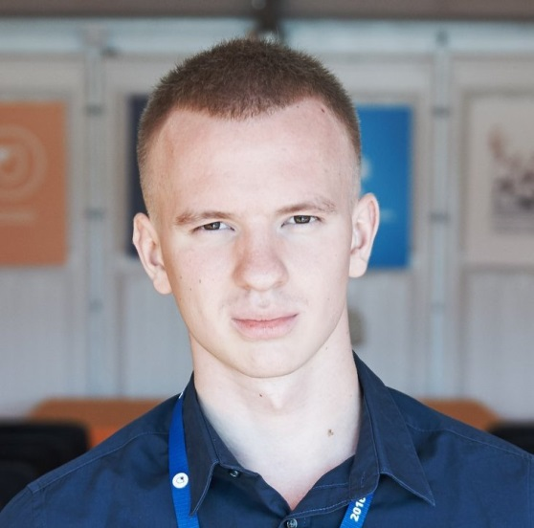
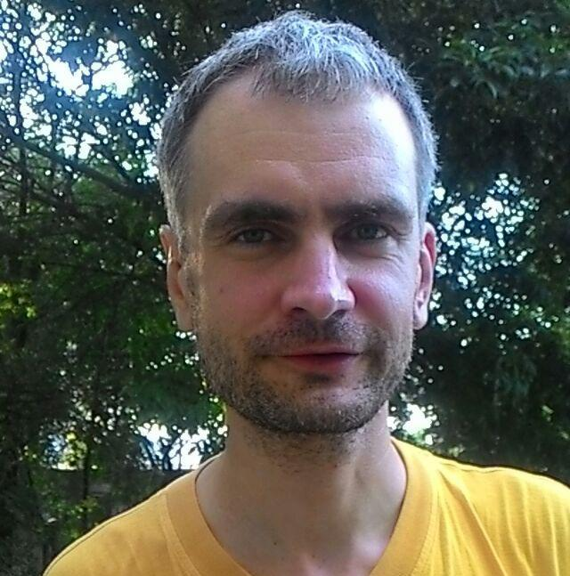
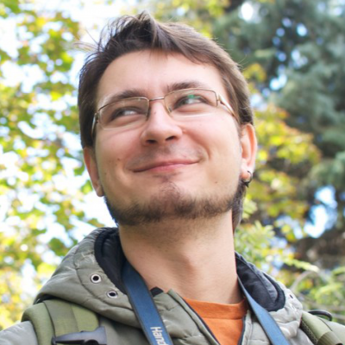
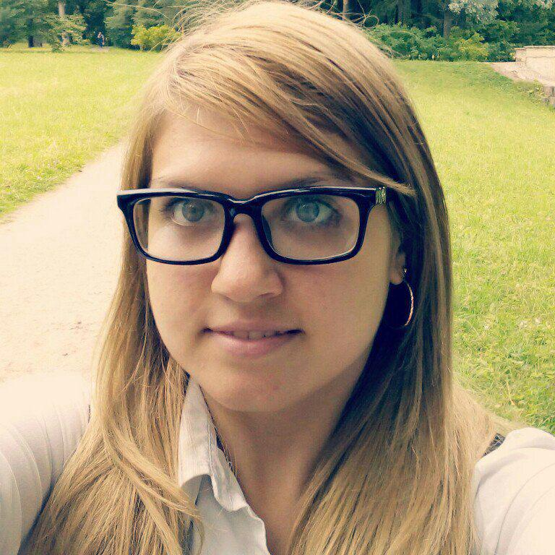
TEAM
Victor Kostyuk
Evgeniy Kondakov
Victor Petrenko
Valeria Dmitrieva

Slide 3
GOALS
Work as a team
Get experience working with real IT-task
Learn new software, tools for practice part
Use modern technology equipment
Create project using different materials
Make handicraft project using knowledge in different spheres

Slide 4
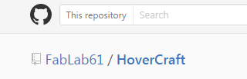
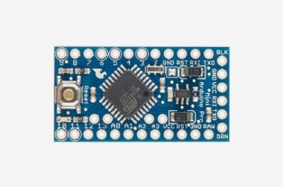
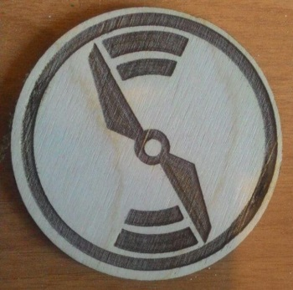
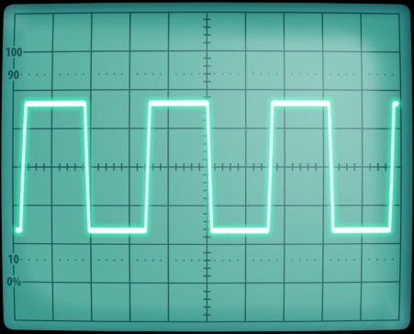
RESULTS
Create and use open-sourced repo (in Github)
Get an experience with microcontroller (Arduino Pro mini on)
Using on practise Laser cut (with InkSkape, Coral Draw, Lasaur App)
Using of an oscilloscope for real tasks

Slide 5
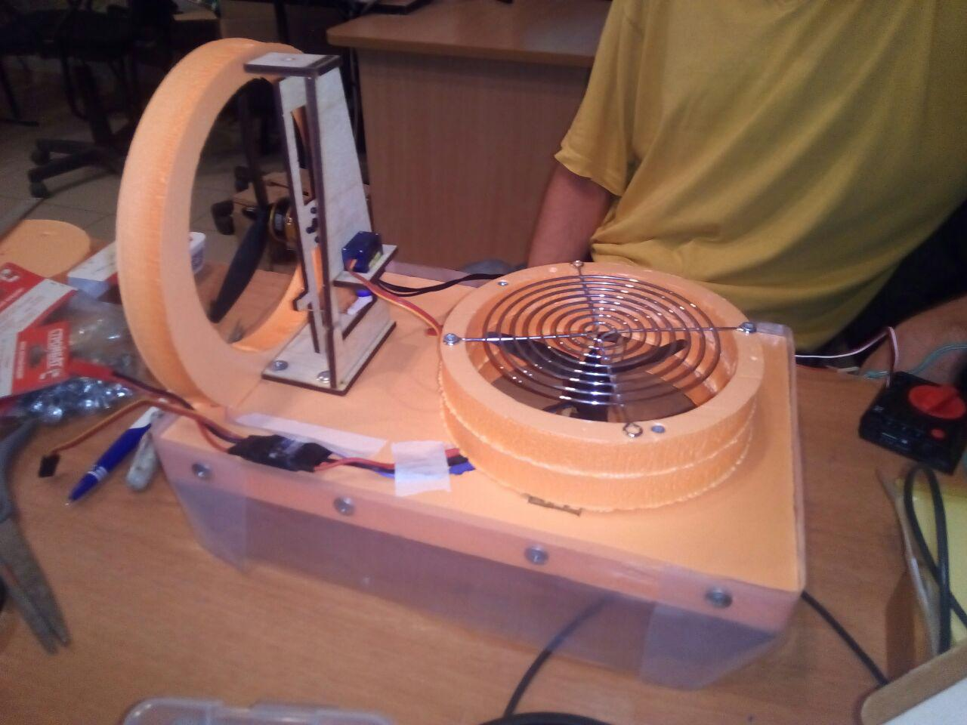
Look at the HoverCraft !

Slide 6
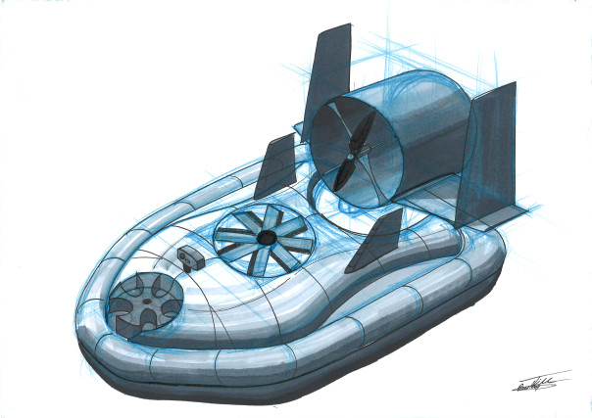
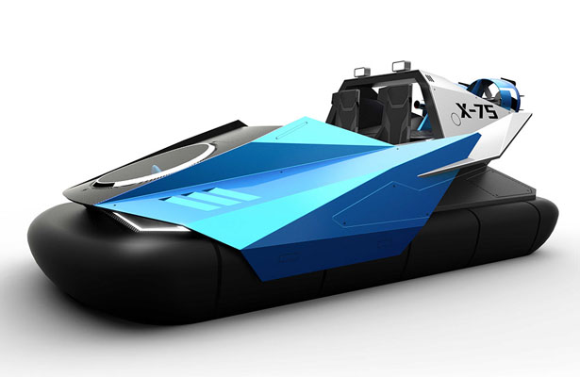
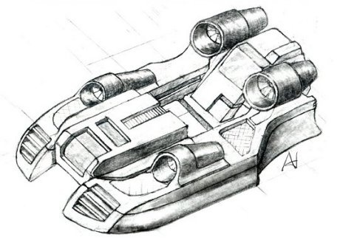
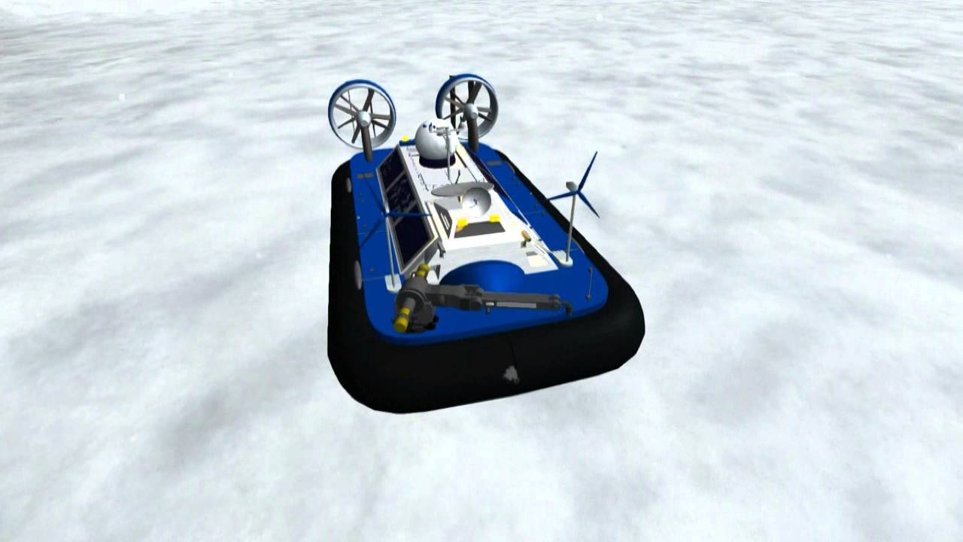
perspective

